Slide 1

Android Destination Application
Department of Information Technology
Galgotias College of Engineering and Technology
Greater Noida
MINI PROJECT - (KIT-752)
2021-2022
PRESENTED TO: Dr. Sandhya katiyar & Ms. Kanika Singhal
PRESENTED BY: Ashish Asthana(1809713024) & Himanshu Mishra(1809713048)
7th semester, Group Number : 2021/7A/14

Slide 2

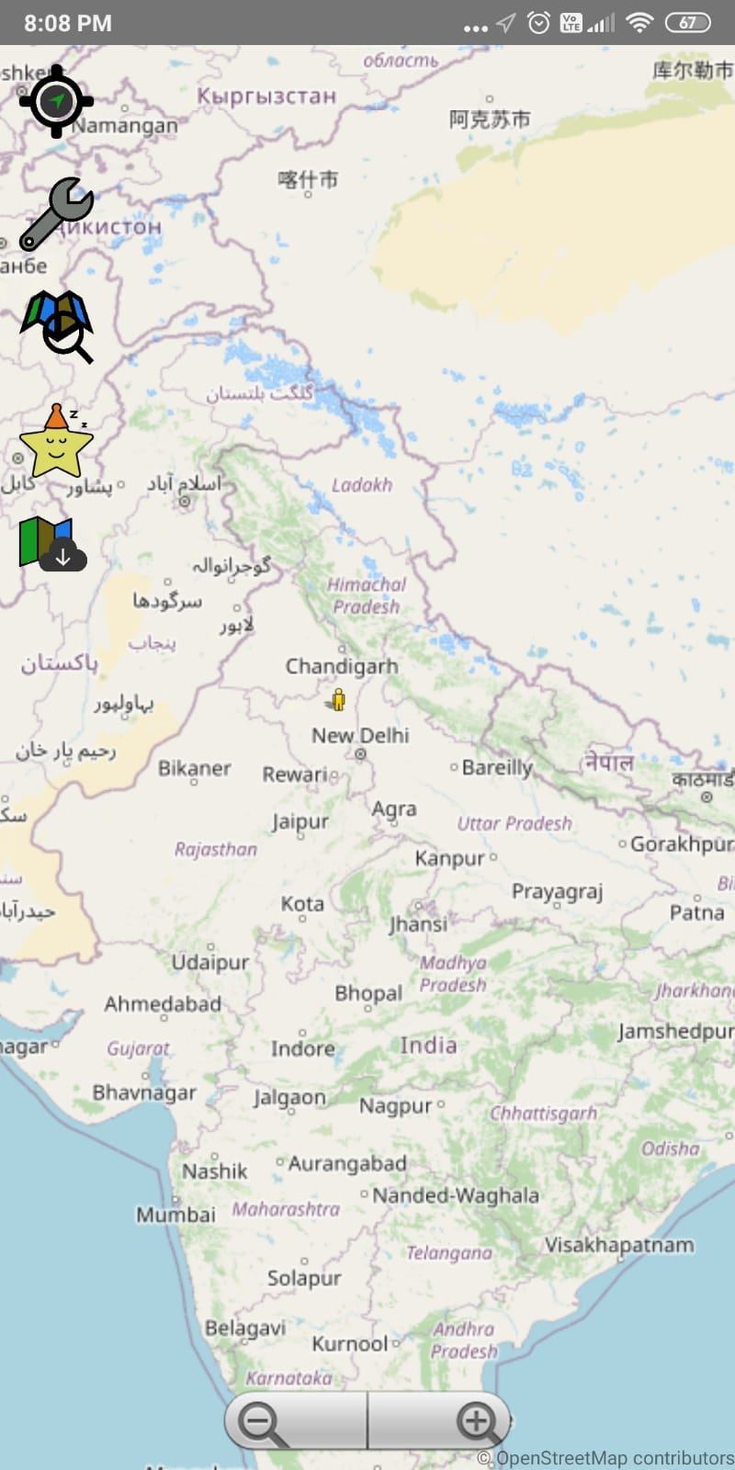
About Project
It is an Android Application which tells user’s when he/she reached their destination which they previously set. In this application user enters the target location then using GPS app tracks user’s current location every second when user reaches near destination an alarm sets off where it tells user that their target location has arrived.

Slide 3
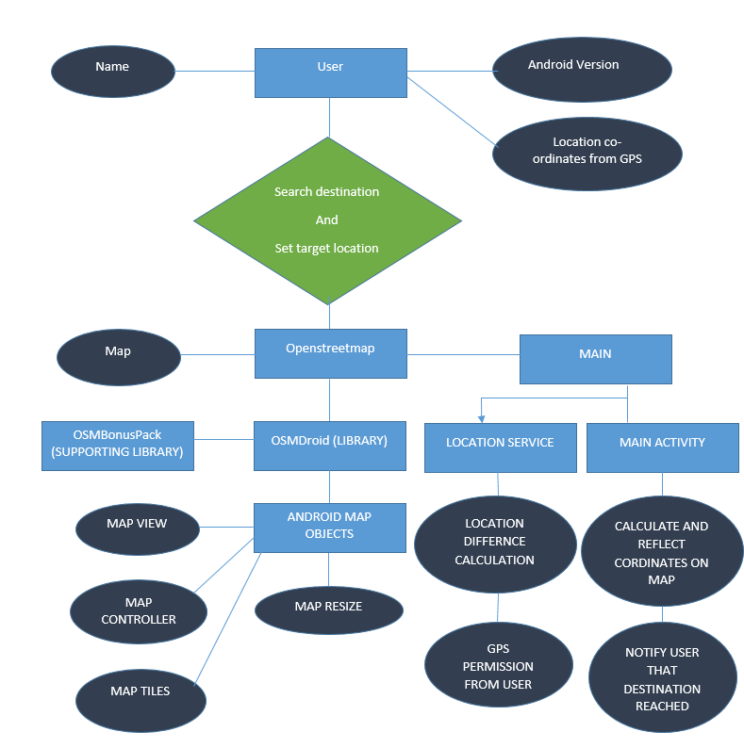
Entity-Relationship Diagram
This ER diagram shows the components of this Android Destination Application.

Slide 4
Steps
Enjoy your journey
When destination is near alarm starts ringing
Set target location
App uses GPS to track current location
Physical Computing
HTML, CSS,JS

Slide 5





Options
Current location
Search Map Icon
Map Marker Icon
Favorite location Icon
Settings Icon

Slide 6
Current Location
When user touches this button a user’s current location appears on map

Slide 7
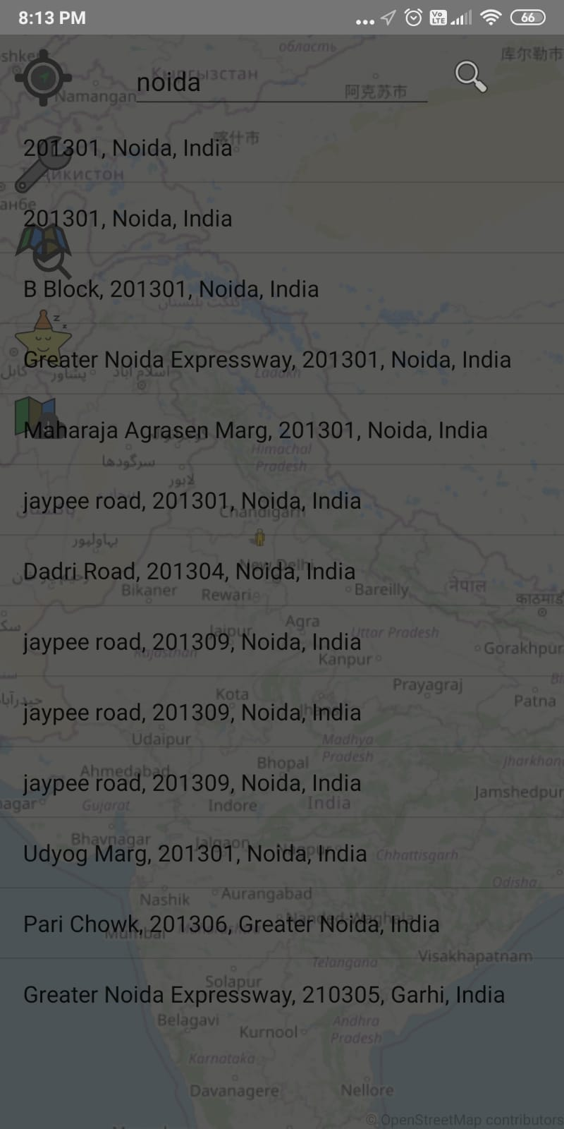
Search Map Icon
When user touches this button a search bar appears where user can write his/her target destination.

Slide 8
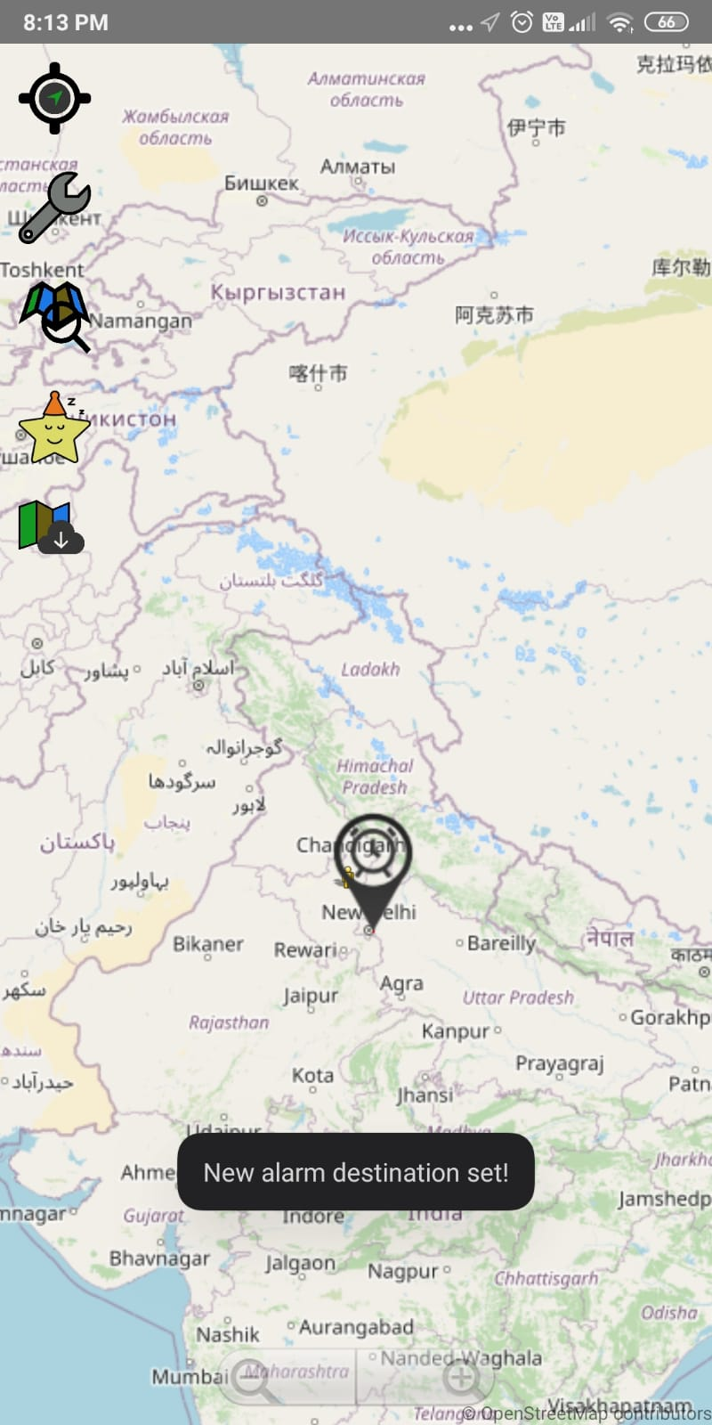
Map Marker Icon
Map Marker shows the target location and radius around it.

Slide 9
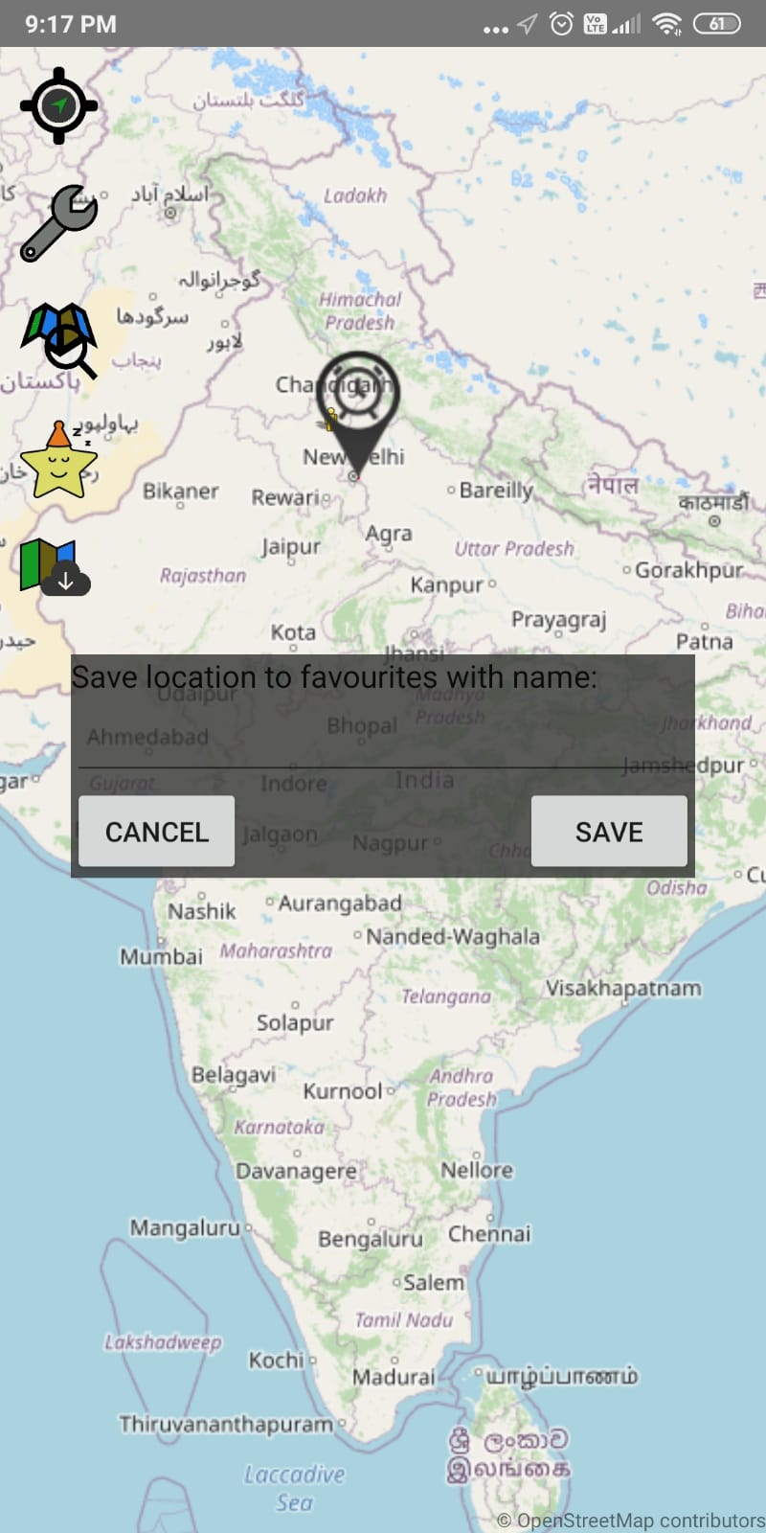
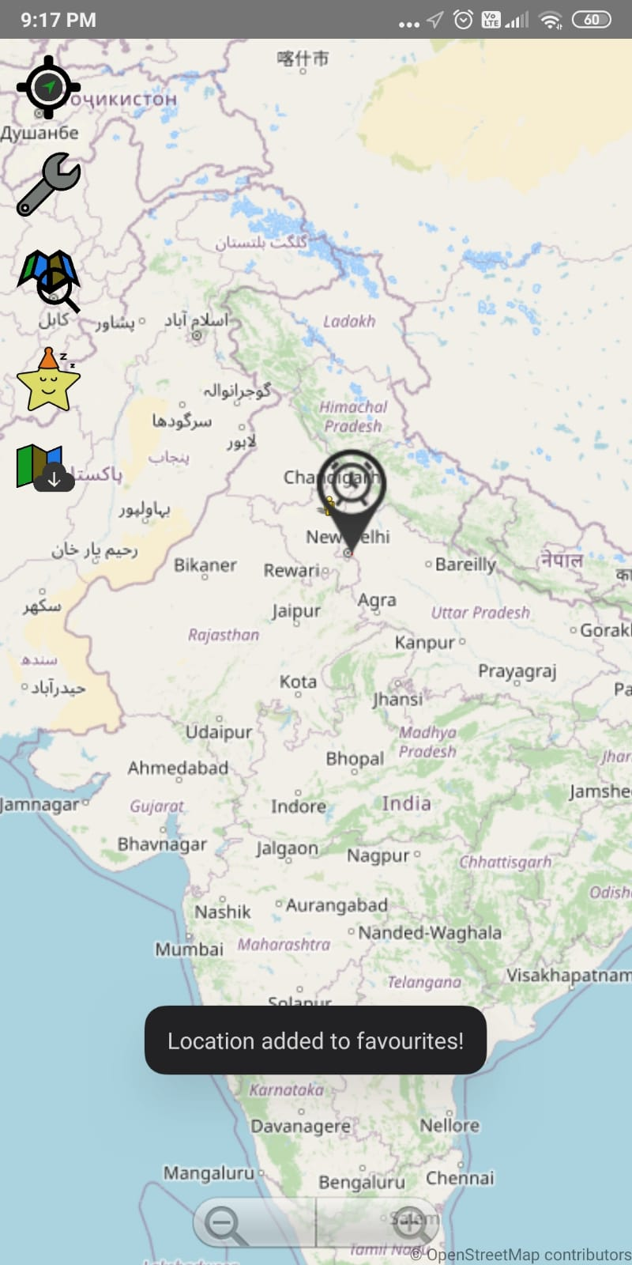
Favorite Icon
Favorite Icon saves the coordinates of users destination so that when user pouches this button, target location gets automatically triggered.

Slide 10
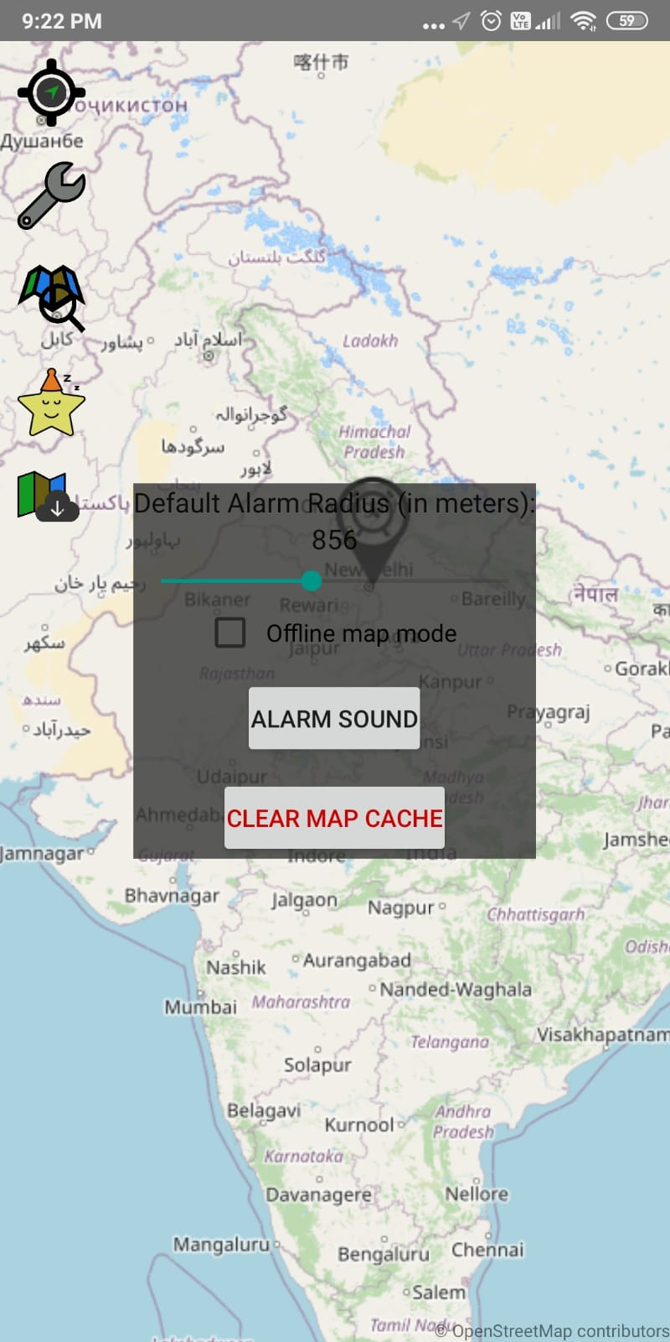
Settings Icon
In settings icon user can set how long will be the alarming radius and the measurements in meters.

Slide 11
Procedure
Step-1:Enter the location
Here we enter the Target Location
In search bar where user have to go..

Slide 12
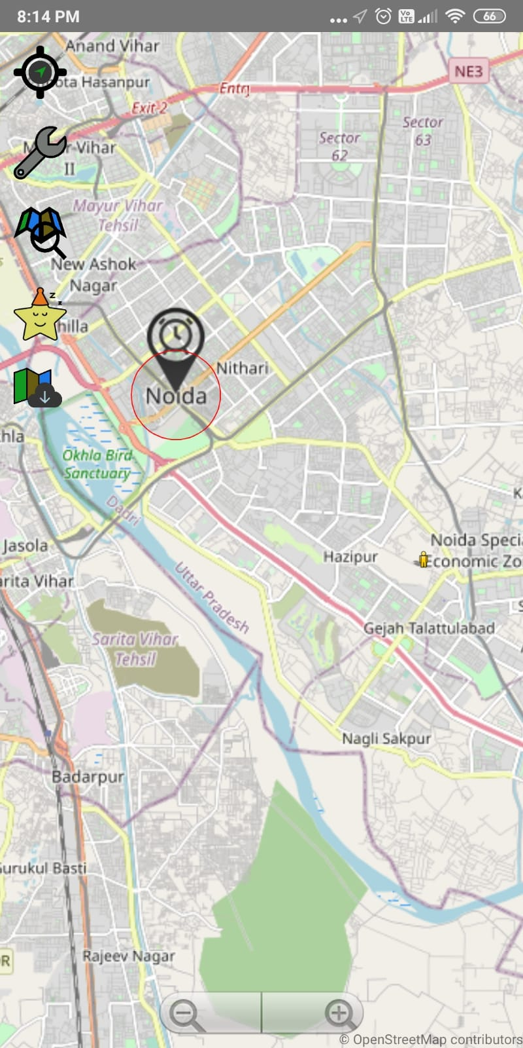
Procedure
Step-2:see the radius
Here user will see the radius near his/her targeted location, it will come handy when user reaches near it , the alarm will set off

Slide 13
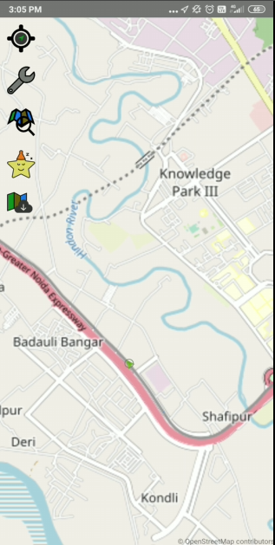
Procedure
Step-3:Enjoy the journey
This is the reason this app is designed on the first place so that user don’t need to track his or her location every time, when any station come along the way , app will notify user in due time remaining when destination has to be arrived.

Slide 14
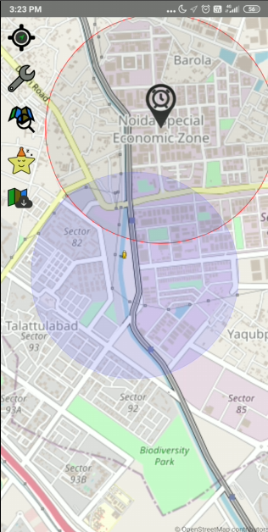
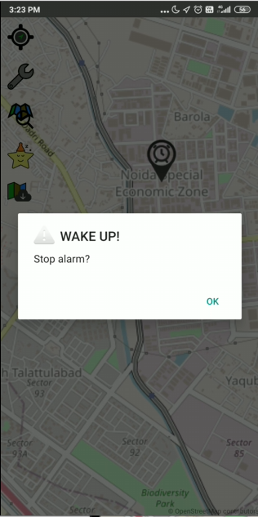
Procedure
Step-4:Alarm notification
When user reaches near the radius the
Alarm notification starts coming until user shut it off.

Slide 15
References
Libraries
[1]OpenStreetMap - https://www.openstreetmap.org
[2]OSMDroid - https://github.com/osmdroid/osmdroid
[3]OSMBonuspack - https://github.com/MKergall/osmbonuspack
[4] kotlin Documentation - https://kotlinlang.org/docs/home.html
[5] Java Documentation - https://docs.oracle.com/en/java/

Slide 16
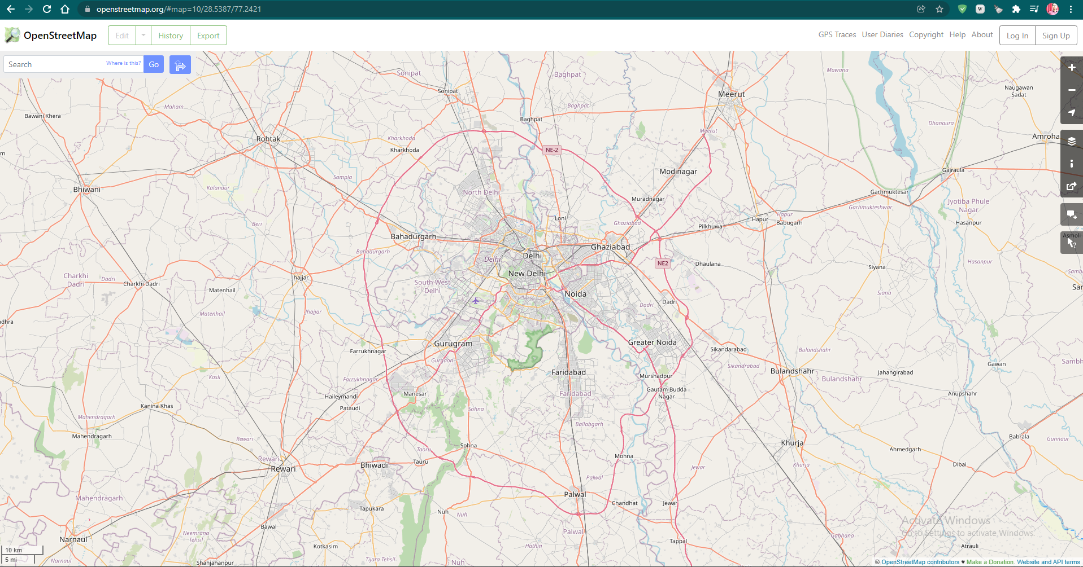
Presented by
Ashish Asthana
1809713024
Himanshu Mishra
1809713048

Slide 17

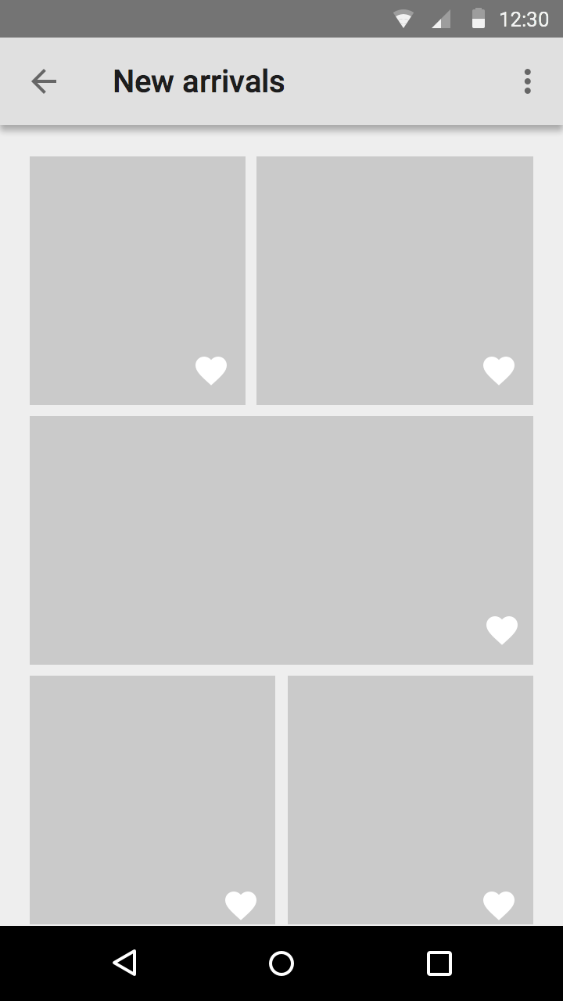
Thank you

